Slide 1
Sentiment-Flex (SF) Fund
Ethan Vanlerberghe
MSDS 451: Financial Engineering
Professor Miller
August 31, 2025

Slide 2
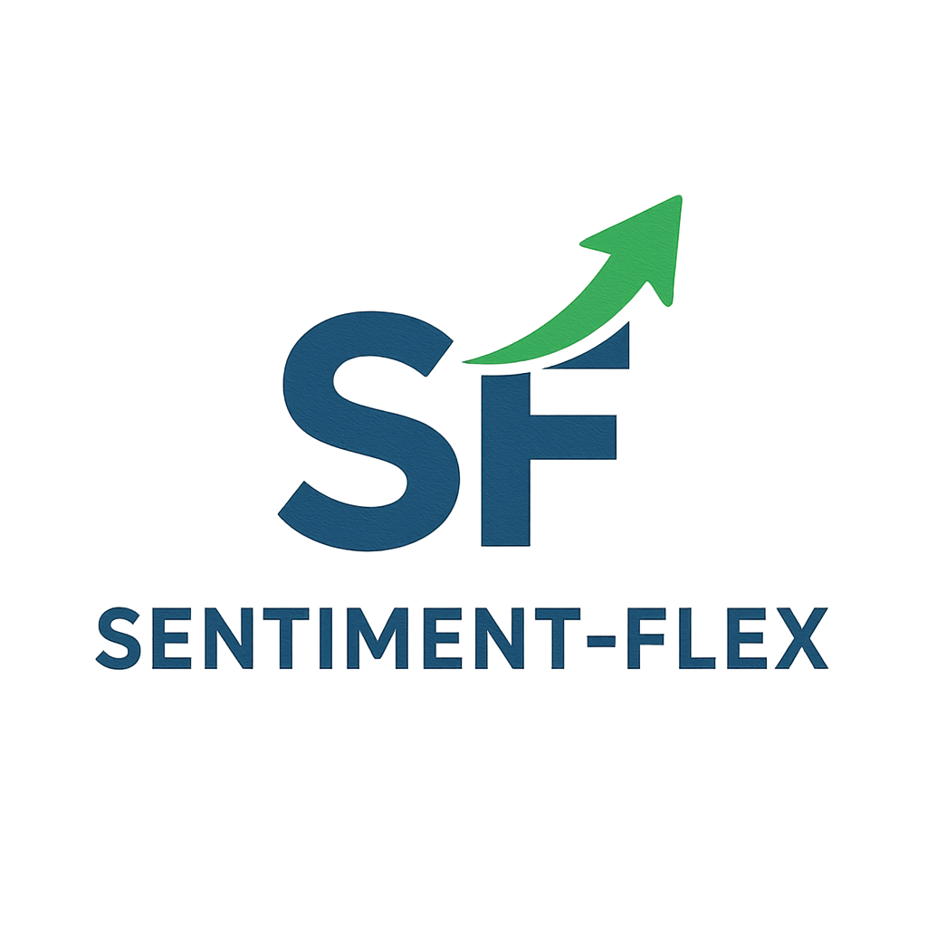
Agenda
Hello and welcome! In this meeting, we will cover:
Fund Introduction
Literature Review
General Investment Philosophy
Investment Methods
Description of Securities
Performance Evaluation
Management Recommendation

Slide 3
Fund Introduction
Goal: Provide Shareholders value through a fund that harnesses the power of Social Media
An unconventional approach to investment methodology
Pair this with technical analysis to decrease volatility
Created to showcase the power behind Social Media
Designed for Generation Z investors

Slide 4

Literature Review
Substantial research performed in this field
Hansen-Han, Shirosaidev, Shapo, ScarletSplendour, AlpacaHQ - All GitHub Sources
Foundations for SF are laid out in Modern Portfolio Theory (MPT)
Basic portfolio and algorithmic trading knowledge - Grinold & Khan, Ross, Wilmott, Miller
Other sentiment-based investing platforms
VanEck, Invesco - Cite how $BUZZ operates

Slide 5
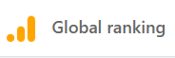
General Investment Philosophy
Reject Efficient Market Hypothesis
Growth-Centered
Momentum-based
Top 10 assets on the NYSE
By Market Capitalization
Goal: Provide Shareholders value through a fund that harnesses the power of Social Media

Slide 6

General Investment Philosophy (Contd.)
Consumer Sentiment Model
Collective Conviction
Significant majority of users leads to overall consumer sentiment
Informed decision making based on sentiment
Monitors across assets

Slide 7

Investment Methods
How does the fund work?
SF selects the top 10 assets in the NYSE by Market Capitalization
Scrapes CompaniesMarketCap.com
These top 10 assets are passed into the AsyncPraw package
Allows for access to the Reddit API
Top 250 reddit posts mentioning the ticker are pulled
Reddit posts are extracted from “WallStreetBets” SubReddit
These reddit posts are then put through VADER Lexicon
Allows for sentiment analysis (Positive or negative)

Slide 8
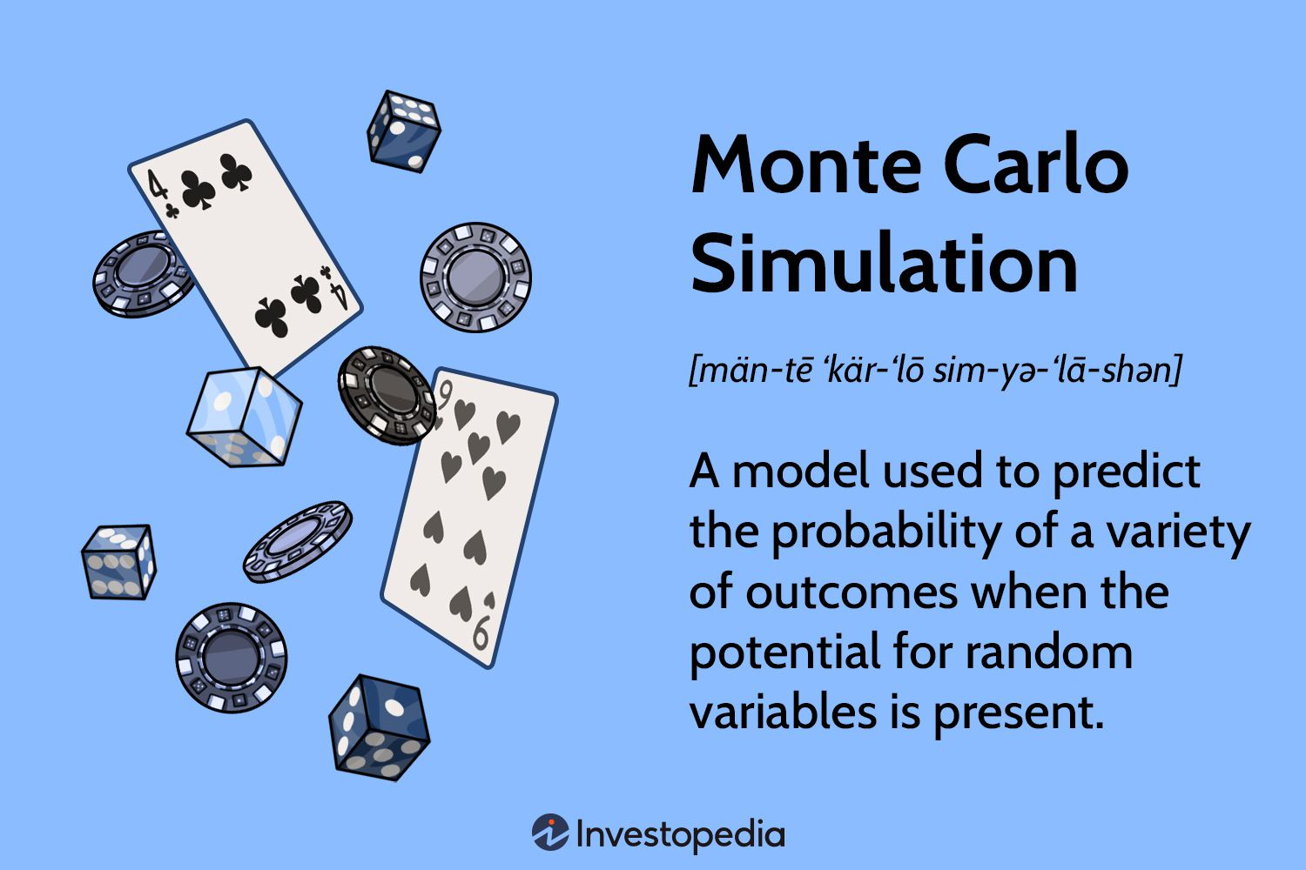
Investment Methods (Contd.)
How does it work? Contd.
SF then attempts to simulate uncertainty in the market through Monte Carlo simulations
Predicts future closing prices for assets
Multivariate method
SF merges the sentiment modifiers as an additional column to the dataframe
SF begins to split this dataset into a test/train 80/20 split chronologically

Slide 9
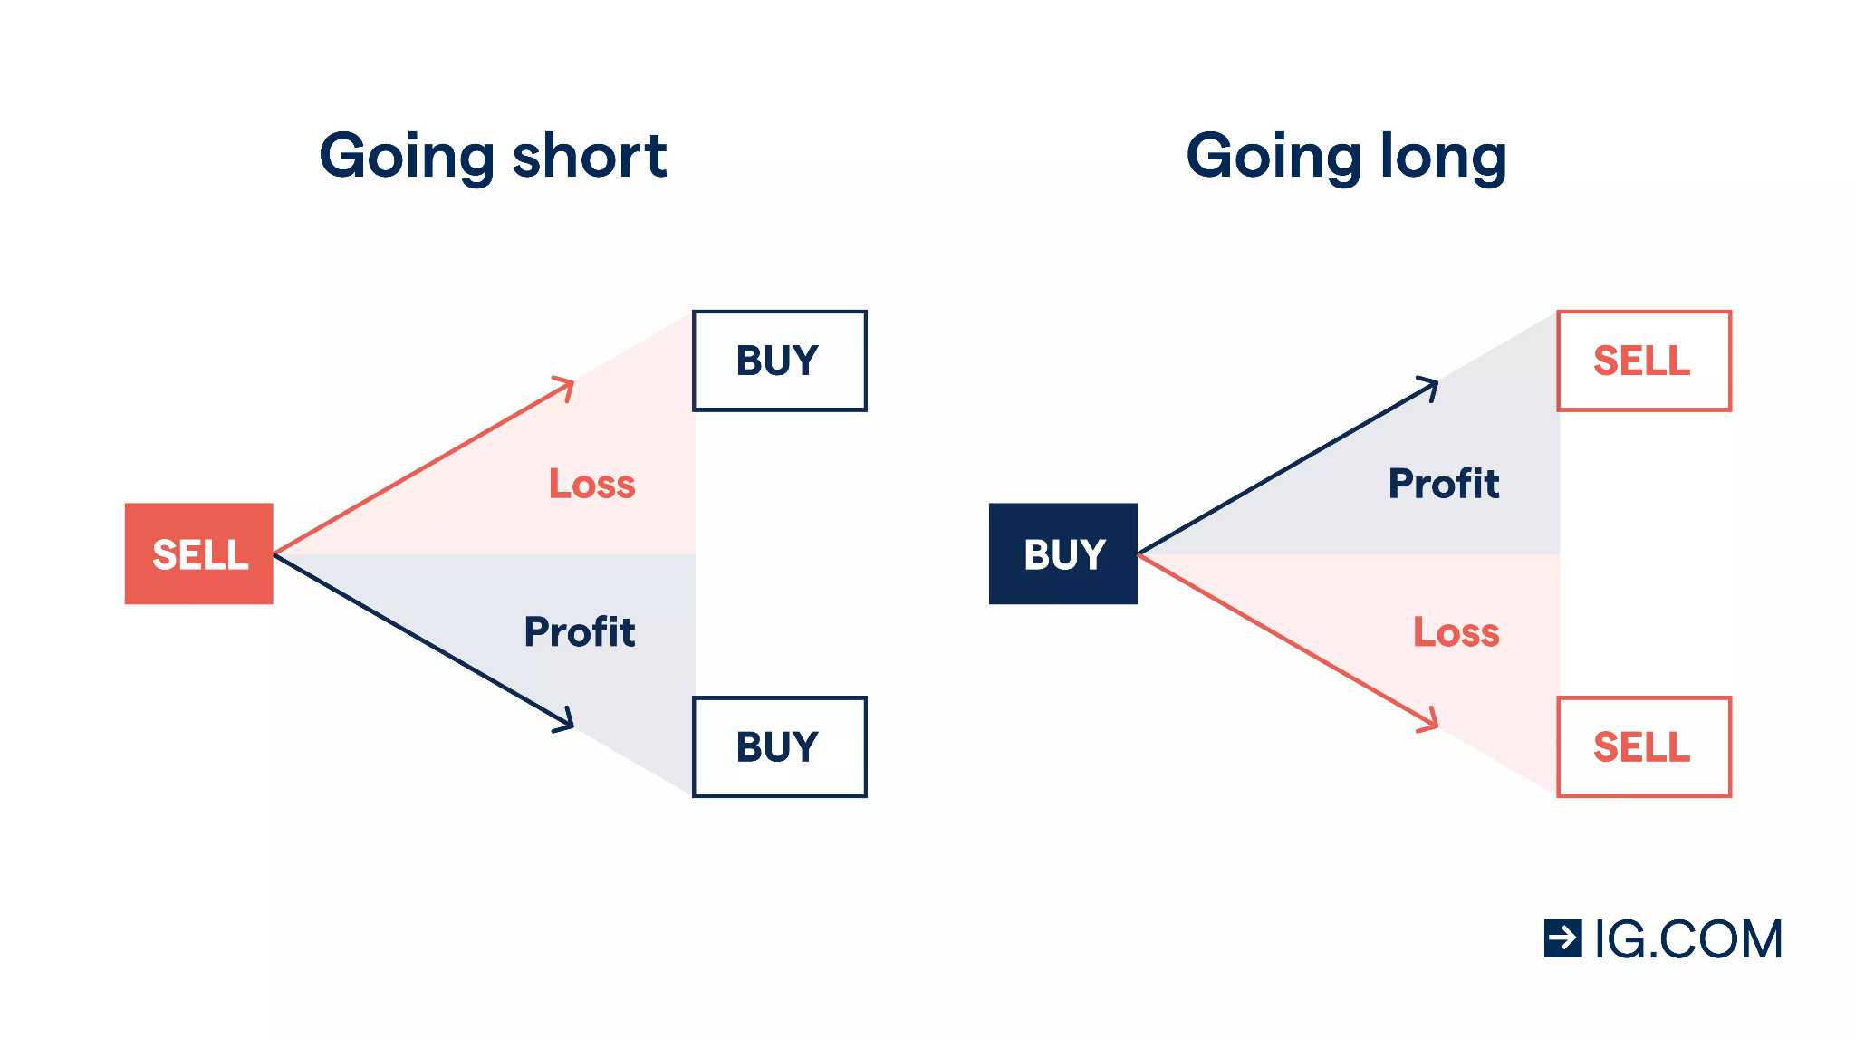
Investment Methods (Contd.)
How does it work? Contd.
SF then creates a flag to indicate predicted next day movement of the asset
1 -> “Up” day (Increase in value predicted)
0 -> “Down” day (Decrease in value predicted)
These are then converted to trading signals
1 -> “Long” (The model should long the asset)
-1 -> “Short” (The model should short the asset)

Slide 10
Investment Methods (Contd.)
How does it work? Contd.
SF finally tests itself against the 20% test set
This is then plotted to visualize performance
Compared to benchmark (S&P 500, ^GSPC)
SF also provides key performance indicators of the fund
Alpha
Beta
Sharpe Ratio
𝛼 𝛽

Slide 11
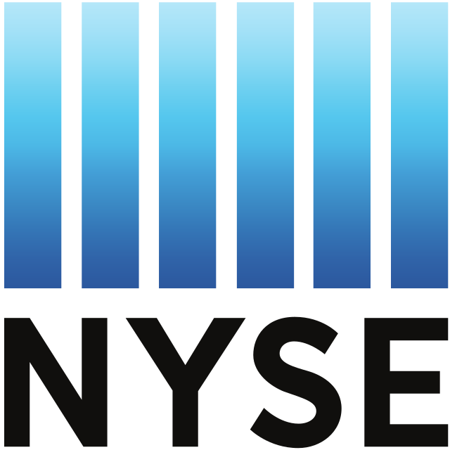
Description of Securities
The SF Fund focuses on the Top 10 highly valued assets traded on the NYSE by Market Capitalization
Selected to ensure sufficient discussion in Social Media feeds
These top 10 assets are then passed into the SF model
The model evaluates these top 10 asset’s mentions in Social Media posts
In following periods, SF reevaluates the top 10 assets, and exchanges assets if necessary
This allows for maintained exposure to the most widely-discussed assets

Slide 12
Performance Evaluation
SF has demonstrated success when backtested
Total returns beat the benchmark (S&P 500 ^GSPC)
Indicates beating the market by 0.96%
Performance Metric | SF Fund Score | Benchmark (S&P 500) Score
Total Return (20% Timeframe) | 12.48% | 11.52%
Sharpe Ratio | 1.3868 | 0.3417
Alpha (Relative) | 0.0008 | N/a
Beta (Relative) | 0.0390 | N/a

Slide 13
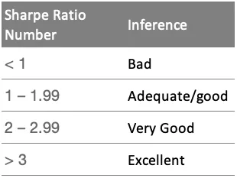
Performance Evaluation (Contd.)
SF has demonstrated success when backtested
Sharpe ratio indicates success when compared to risk
Indicates beating the market by 1.0451
Performance Metric | SF Fund Score | Benchmark (S&P 500) Score
Total Return (20% Timeframe) | 12.48% | 11.52%
Sharpe Ratio | 1.3868 | 0.3417
Alpha (Relative) | 0.0008 | N/a
Beta (Relative) | 0.0390 | N/a

Slide 14
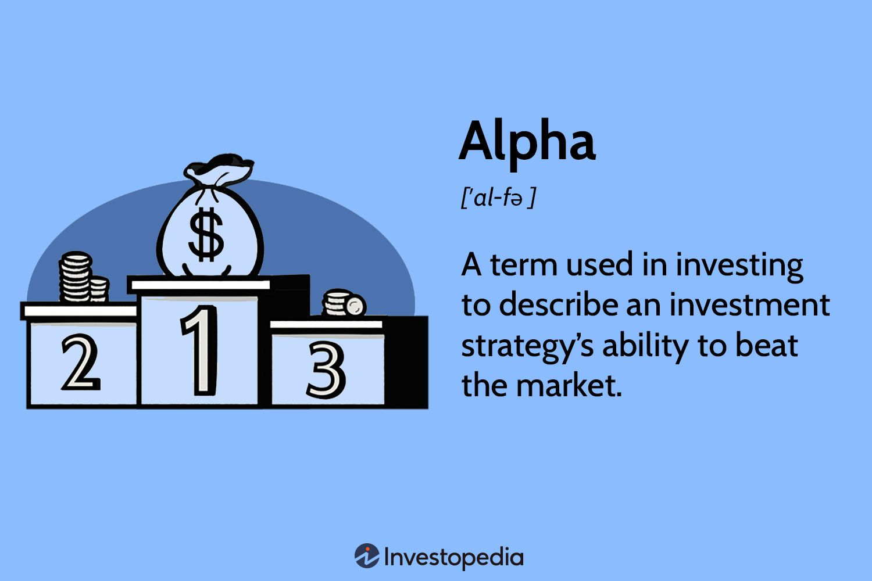
Performance Evaluation (Contd.)
Alpha value indicates success when backtested
Alpha ratio indicates performance over the benchmark (S&P 500 ^GSPC)
Performance Metric | SF Fund Score | Benchmark (S&P 500) Score
Total Return (20% Timeframe) | 12.48% | 11.52%
Sharpe Ratio | 1.3868 | 0.3417
Alpha (Relative) | 0.0008 | N/a
Beta (Relative) | 0.0390 | N/a

Slide 15
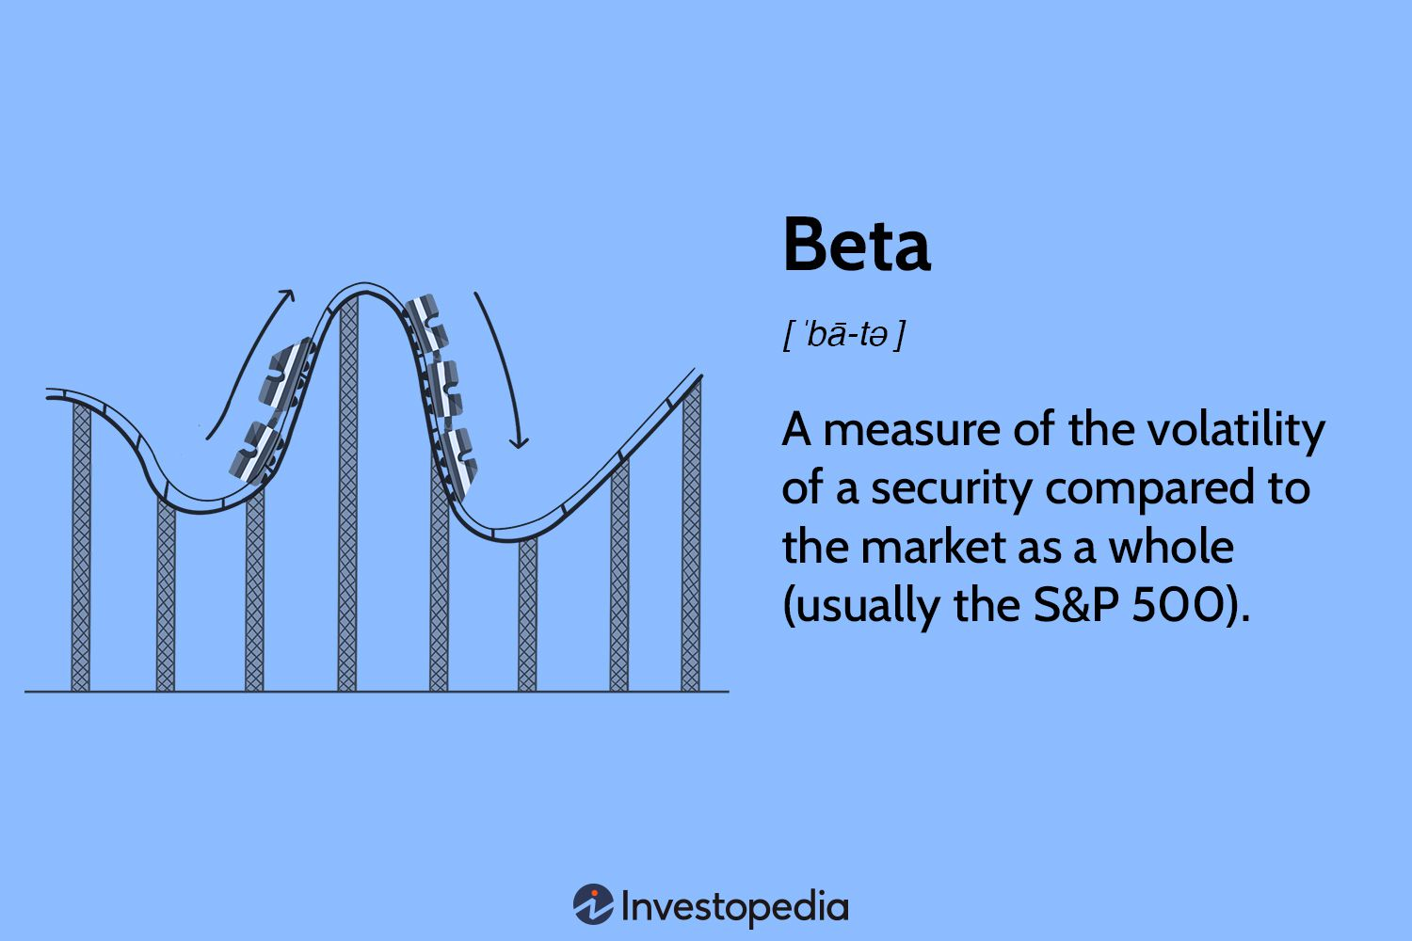
Performance Evaluation (Contd.)
Beta value indicates success when backtested
Beta ratio indicates lower volatility than the benchmark
Performance Metric | SF Fund Score | Benchmark (S&P 500) Score
Total Return (20% Timeframe) | 12.48% | 11.52%
Sharpe Ratio | 1.3868 | 0.3417
Alpha (Relative) | 0.0008 | N/a
Beta (Relative) | 0.0390 | N/a

Slide 16
Management Recommendation
Overall, the SF model reflects outperformance of the S&P 500 with lower volatility
Blue Chip, Large Cap focus
Unique approach to value appraisal
Backed with traditional value appraisals
Harnesses the power of Social Media
I would take on the role of Chief Investment Officer (CIO)
Allow me to ensure that the fund is being ran as it was imagined
Allow me to manage risk management and ensure a safe deliverable

Slide 17
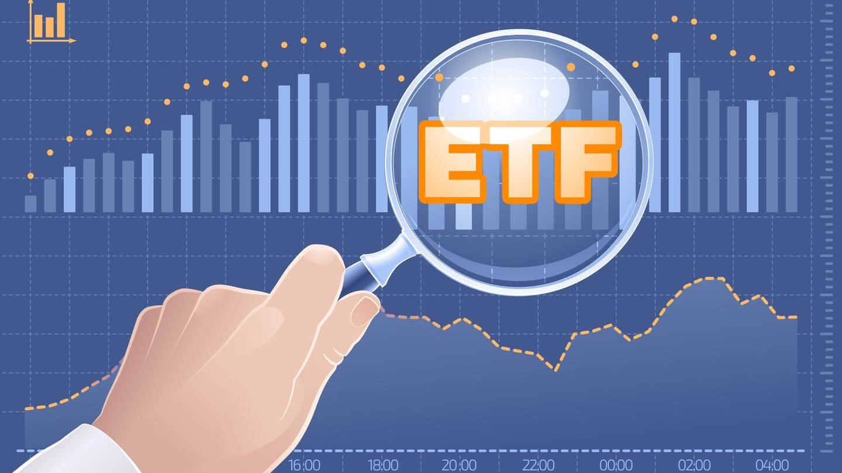
Management Recommendation
Overall, I believe that the fund could see success in the marketplace, with a few conditions
The fee structure should be re-evaluated to allow for greater income
The overhead for capital for the fund needs to be kept low
An official business plan, Go-to-market strategy, and market saturation study

Slide 18
Lessons Learned
Could Improve accuracy by bringing in additional datasets
Sentiment analysis of crypto-related conversations on multiple Social Media
X
Threads
Facebook
Test using alternate accelerators besides straight CPU acceleration
Reduce model building time
Build a model across more than 10 assets

Slide 19
Questions?

Slide 20
Appendix A
Abraham, Stephan A. “How to Create Your Own ETF.” Investopedia, April 1, 2015. https://www.investopedia.com/articles/investing/040115/how-create-your-very-own-etf.asp.
Adams, Douglas. The Hitchhiker’s Guide to the Galaxy. Pan Books, 1979.
Alós-Ferrer, Carlos, and Federico Iriberri. “The Effect of Social Media on Financial Markets.” Journal of Economic Behavior & Organization 154 (2018): 292–312. https://www.sciencedirect.com/science/article/abs/pii/S1042443118303093.
AlpacaHQ. Momentum Trading Example. GitHub, 2023. https://github.com/alpacahq/Momentum-Trading-Example.
Dierking, Dave. “ETFs 101: My Basic Criteria for Choosing an ETF.” Seeking Alpha, December 17, 2018. https://seekingalpha.com/instablog/5366071-dave-dierking-cfa/5210721-etfs-101-basic-criteria-for-choosing-etf.

Slide 21
Appendix B
Grinold, Richard C., and Ronald N. Kahn. Active Portfolio Management: Quantitative Theory and Applications. Probus, 1995.
Hansen-han. “alpaca_sentiment_trader.” GitHub, 2025. https://github.com/hansen-han/alpaca_sentiment_trader.
“Holdings & Sector Allocations of Invesco QQQ.” Invesco. https://www.invesco.com/qqq-etf/en/about.html.
Koetsier, John. “Gen Z Dumping Google for TikTok, Instagram as Social Search Wins.” Forbes, March 11, 2024. https://www.forbes.com/sites/johnkoetsier/2024/03/11/genz-dumping-google-for-tiktok-instagram-as-social-search-wins/.
Miller, Tom. “451 Feature Engineering: Programming Assignment 1.” 2025.
—. “Week 6 Term Project Checkpoint B.” Lecture, 2025.

Slide 22
Appendix C
“Modern Portfolio Theory.” Wikipedia. Wikimedia Foundation, July 29, 2025. https://en.wikipedia.org/wiki/Modern_portfolio_theory.
Quimbayo, C. A. Z. “Robust Bayesian Portfolio Optimization.” Journal of Operations Management, 2025. https://doi.org/10.1016/j.jom.2025.05.004.
Raghav. “MonteCarloSimStockPrices.” GitHub, 2025. https://github.com/RaghavsScarletSplendour/MonteCarloSimStockPrices.
Real Trading™ Staff. “How to Start a Trading Office and Make It Profitable.” Real Trading, April 28, 2023. https://realtrading.com/trading-blog/start-profitable-trading-floor-2/.
Ross, Sheldon M. An Elementary Introduction to Mathematical Finance. Cram101, 2016.

Slide 23
Appendix E
Shapo, Misha. “Simulating Stock Prices with Monte Carlo Methods.” GitHub, 2025. https://github.com/MishaShapo/Monte_Carlo_Stocks/blob/master/Simulating_Stock_Prices_with_Monte_Carlo_Methods.ipynb.
—. “Simulating Stock Prices with Monte Carlo Methods.” YouTube, 2025. https://www.youtube.com/watch?v=6-dhdMDiYWQ.
—. “Stock Trading Principles.” YouTube, 2025. https://www.youtube.com/playlist?list=PLvcbYUQ5t0UHdm6bNx3Rnj1fdpt9sGNsm.
Shirosaidev. “stocksight.” GitHub, 2025. https://github.com/shirosaidev/stocksight.
Thompson, Cedric. “Fundamental vs. Technical Analysis: What’s the Difference?” Investopedia. https://www.investopedia.com/ask/answers/difference-between-fundamental-and-technical-analysis/.

Slide 24
Appendix A
VanEck. “$BUZZ Prospectus.” SEC.gov. https://www.sec.gov/Archives/edgar/data/1137360/000113736025000087/vanecksocialsentimentetfbu.htm.
—. “Buzz – VanEck Social Sentiment ETF: Holdings & Performance.” VanEck, June 2, 2023. https://www.vaneck.com/us/en/investments/social-sentiment-etf-buzz/.
Volpicelli, Gian M. “This Was the Year When Finance Jumped the Doge.” Wired, December 29, 2021. https://www.wired.com/story/defi-gamestop-memes-doge-musk/.
Wilmott, Paul. Frequently Asked Questions in Quantitative Finance. Playaway Digital Audio, 2008.
Zhong, Sam. “Stock_Trading_Reddit.” GitHub repository, 2025. https://github.com/Sam120204/Stock_Trading_Reddit.

